Slide 1
Ksoc Tool user guideline
release-60000-001-v2.0.0-20211025

Slide 2
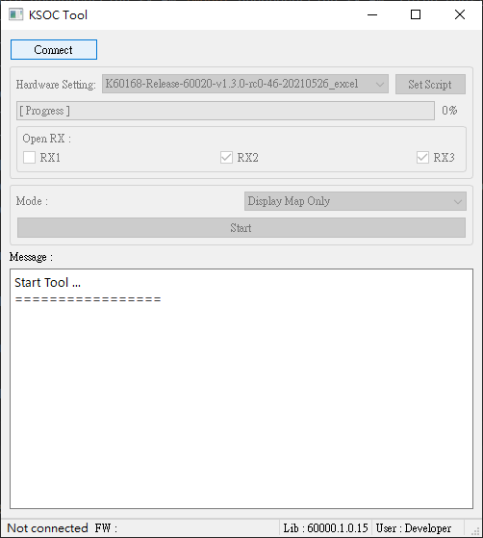
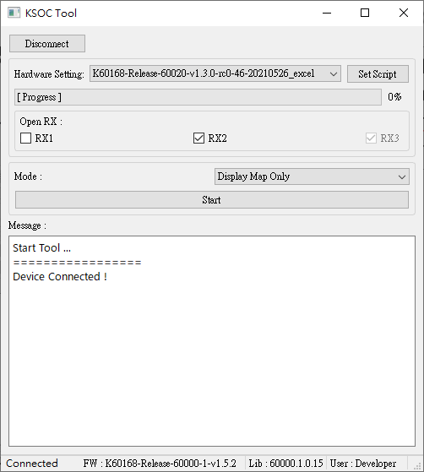
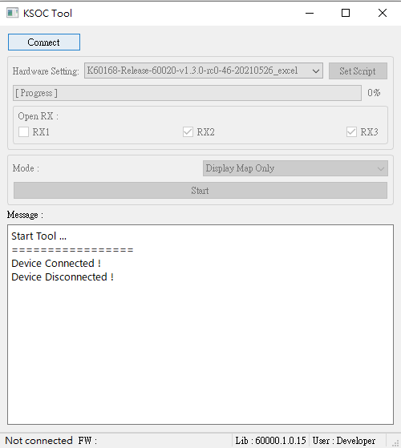
Connect Device
Press
“Connect”
Press
“Disconnect”
Press “Connect” to connect the device and enable interface.
When device was connected, it will show the firmware version.

Slide 3
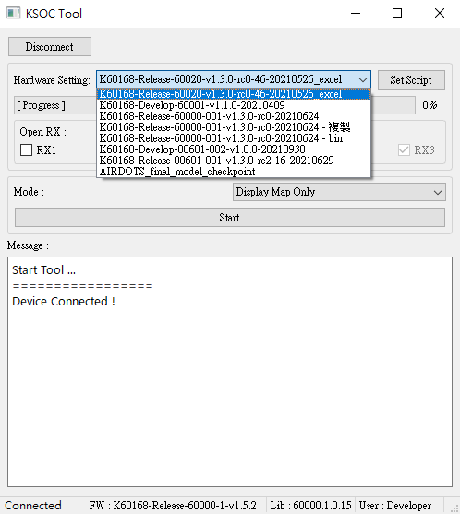
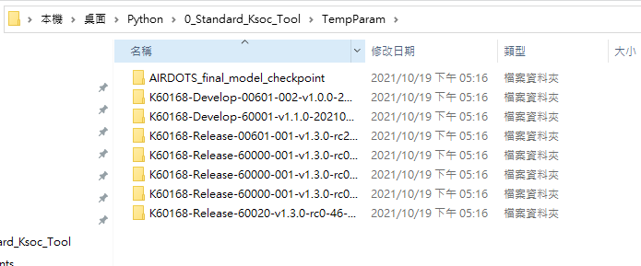
Select parameter
Set script button
First choose a setting folder in the setting list .
After you choose the setting , press “Set Script” to run the setting process.
If you want to update or add some settings, put it in “ TempParam ” directory.
Setting list
Setting path: “ ./TempParam ”

Slide 4
Modes

Slide 5
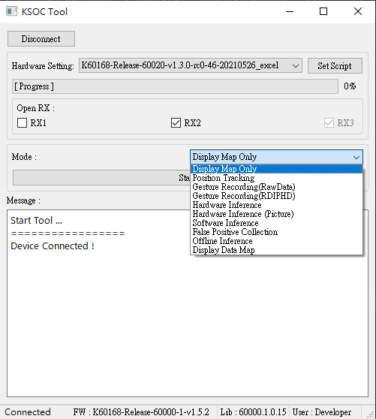
Modes
Display raw data and feature map.
Tracking object’s 2D position.
Gesture recording and save Raw data.
Gesture recording and save feature map.
Hardware inference result and show exponential
Hardware inference result light up pictures when trigger gesture.
Software inference.
Auto saving data when false positive gesture trigger.
Offline machine learning AI results.
10. Display recorded raw data or feature map.
1.
2.
3.
4.
5.
6.
7.
8.
9.
10.

Slide 6
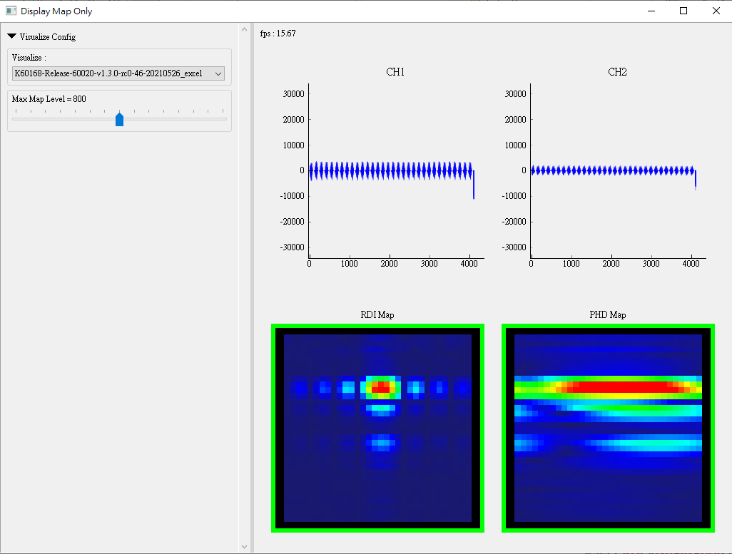
Display map only
Select map visualization config
Adjust maps max level
Show raw data amplitude
in real time.
Show RDI and PHD map
in real time.
Border light up when object
in recognize region.

Slide 7
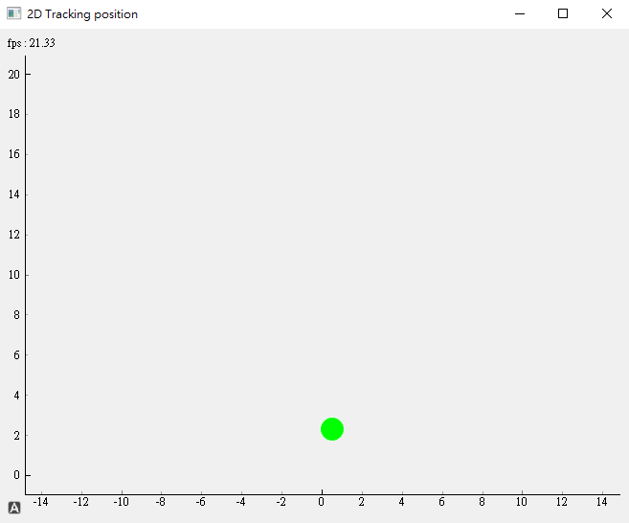
Position Tracking
The ball will show the tracking axis results, it is referred to object’s 2D position.
The dot become green when the object is in the recognized region.

Slide 8
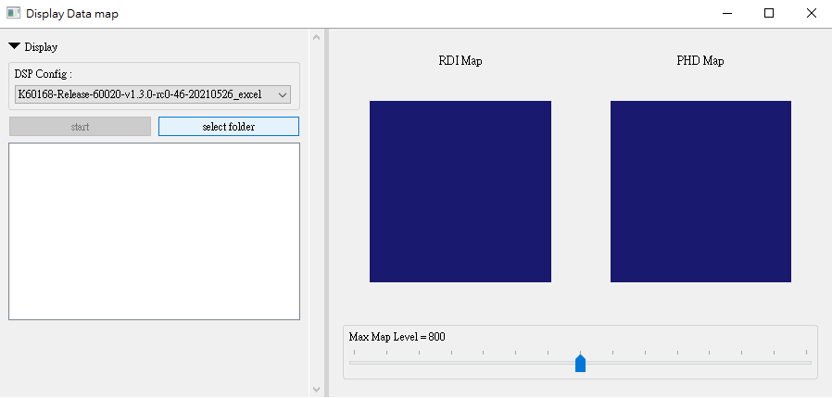
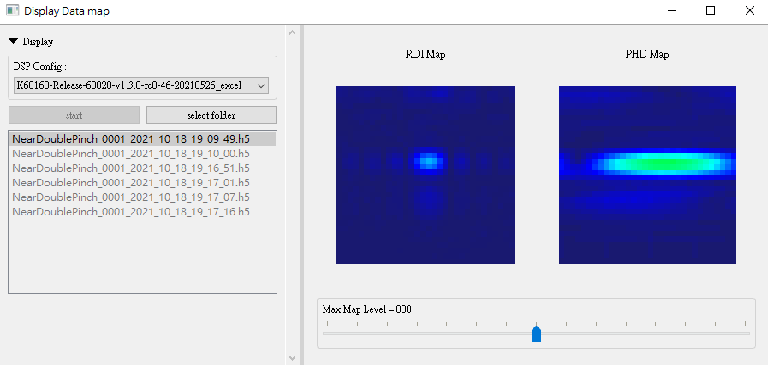
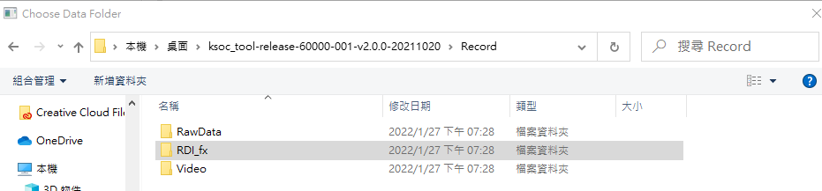
Display Data Map
Press “Start” to show feature maps
Select data directory
Recorded data path: “ ./Record ”
Select a h5 files folder path (Only load .h5) and you’ll get a file list.
If the same dsp config as the .h5 file needs to be applied, the dsp config should be selected accordingly first.
Choose a h5 file and press “start” button after clicked h5 file you want to display on the file list .

Slide 9
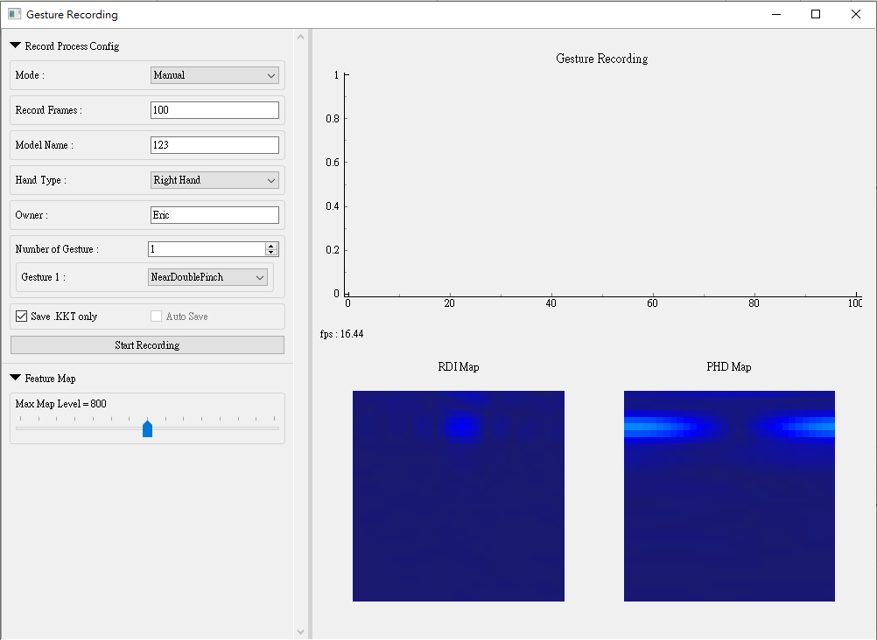
Gesture Recording
Set the configs of recording process before start recording.
Press “Start Recording” to start the recording process.
When Number of Gesture is zero, you can collect background data.
Frames of recording process
Gesture triggered
Recording configs.
Feature map

Slide 10
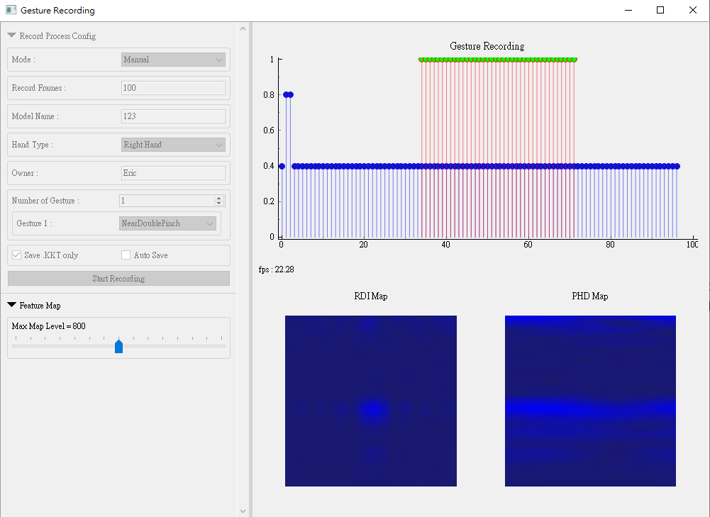
Gesture Recording
Gesture region bars,
number of gesture region =1
When you are in the “Manual” mode, you have to add gesture collection region by yourself, the number of gesture must be same as number of gesture region.
Press key 0~9 in the beginning of gesture region and don’t release until the end of the region.
When you are recording in raw data ,frame count region bars length will be 0.8 if object is in the recognizable region else is 0.4. If recording in RDI PHD map, it will always be 0.8
Default recording file is a .kkt file. If “Save .KKT only” option not checked, both .kkt file and .h5 file will be generated
Mode = “Manual”
Beginning(press)
End(release)
Pressed
Number of gesture = 1
Frame count region bars
Feature map

Slide 11
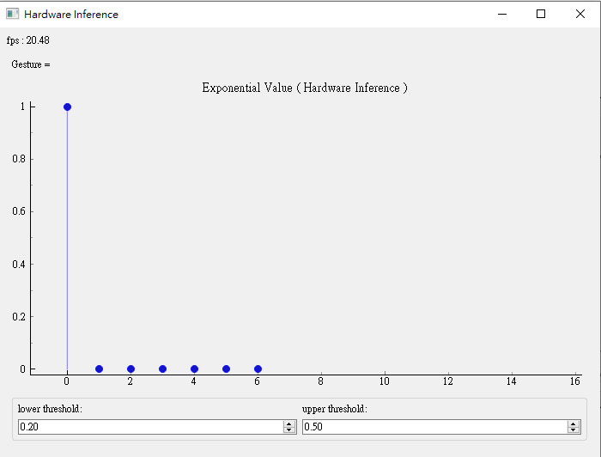
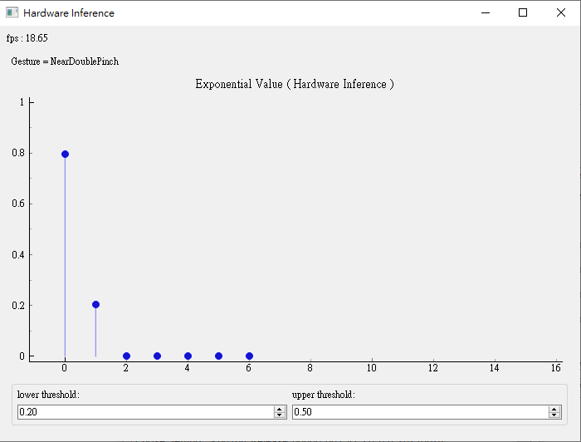
Hardware Inference
Triggered gesture.
Gesture triggered
Adjust post processing threshold.
Show hardware inference result when the gesture was detected.
When the gesture 1 was detected bar 1 will go high .
Gesture triggered when gesture bar is higher than upper threshold and go back to background when gesture bar go lower than lower threshold.

Slide 12
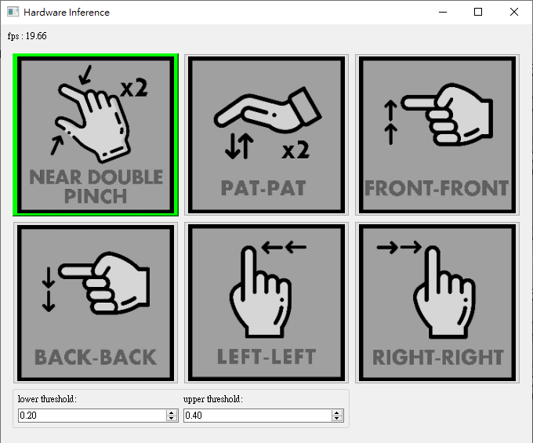
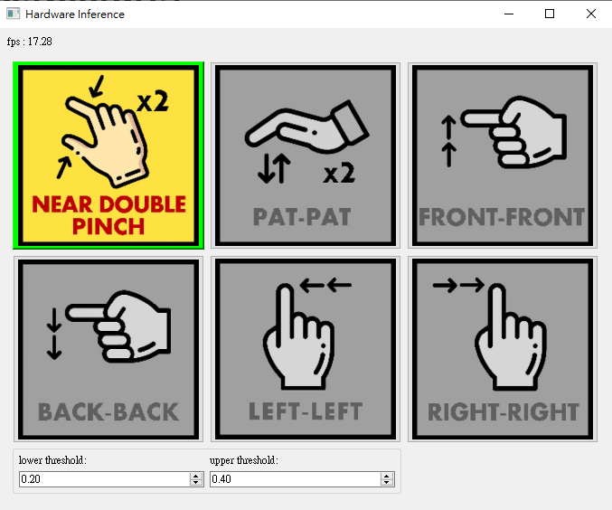
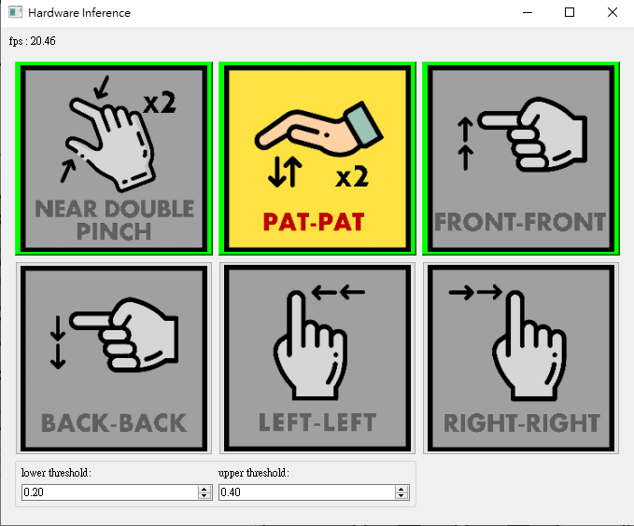
Hardware Inference(picture)
Show hardware inference results when the gesture was detected.
Clicked the picture to unlock the gesture for which can be detected. (border become green)
When the gesture 1 was detected, picture number 1 will light up.

Slide 13
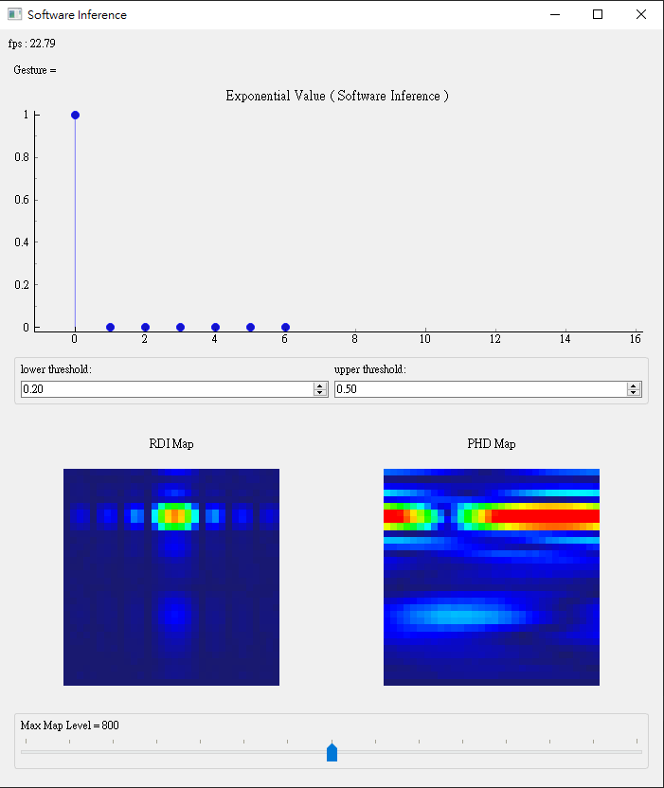
Software Inference
Similar to “Hardware Inference”. It shows software algorithm inference results when the gesture was detected.
It also shows feature maps from hardware.
When the gesture 1 was detected bar 1 will go high .
Gesture triggered when gesture bar is higher than upper threshold and go back to background when gesture bar go lower than lower threshold.

Slide 14
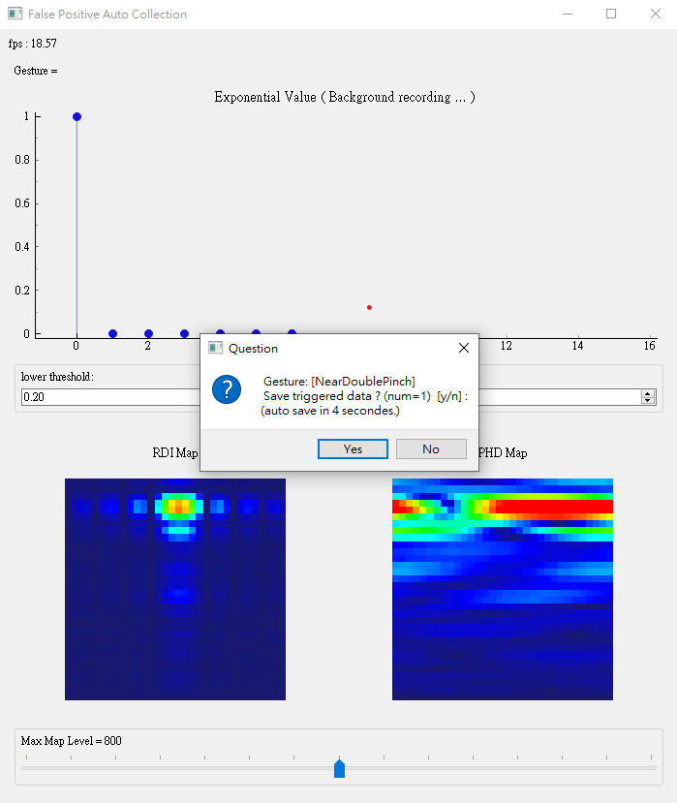
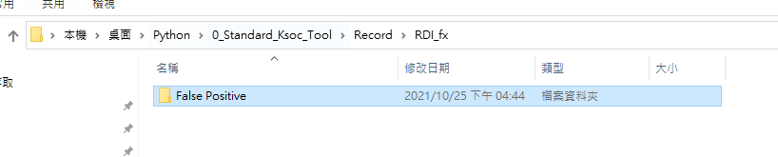
False Positive
It shows software algorithm inference results when the gesture was detected.
It also shows feature maps from hardware.
When the gesture 1 was detected bar 1 will go high .
Gesture triggered when gesture bar is higher than upper threshold and go back to background when gesture bar go lower than lower threshold.
It will auto save last 50 frames and later 49 frames false positive gesture was triggered.
Recorded data path: “ ./Record/RDI_fx/False positive/ ”

